Slide 1
Task 6

Slide 2
Steps of work
Data Preparation
Model Development
Model Evaluation and Comparison
Interface Design and Implementation

Slide 3
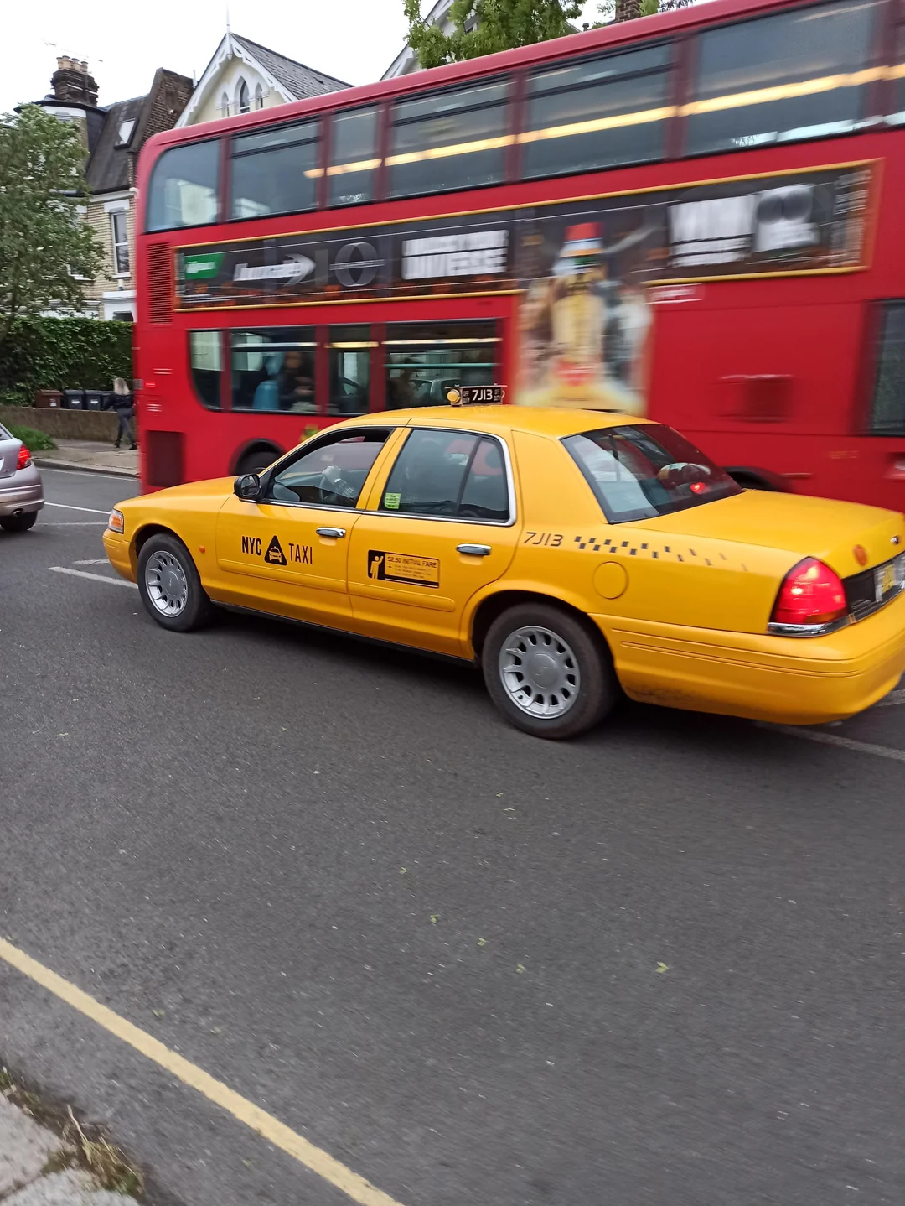
Taxi Fare Estimation

Slide 4
Data Prepration

Slide 5
Data preparation
Removing Outliers
Strings encoding
Dropping irrelevant columns
Data Splitting

Slide 6
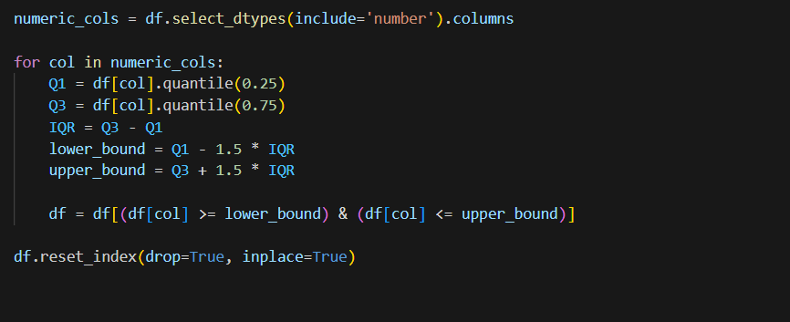
Data preparation

Slide 7
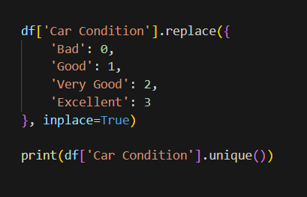
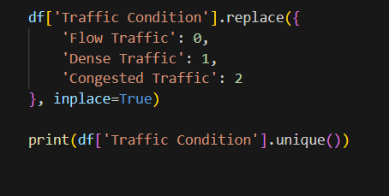
Data preparation

Slide 8
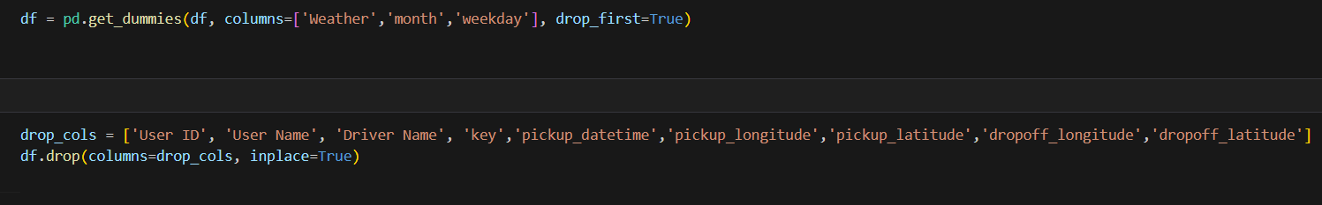
Data preparation

Slide 9
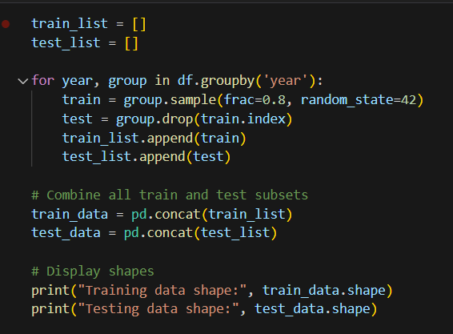
Data preparation

Slide 10
Model development

Slide 11
Model development
Linear Regression
Polynomial Linear Regression
Random forest Regression
Gradient Boosting Regression
XGB Boost
ADA Boost
Decision Tree Boosting

Slide 12
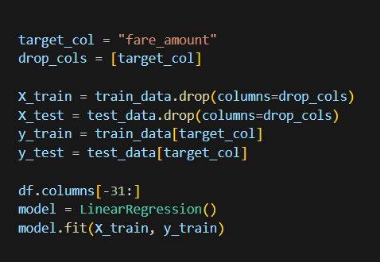
Model Development

Slide 13
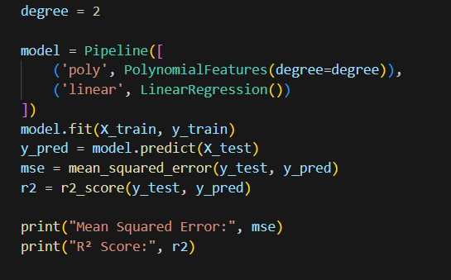
Model Development

Slide 14
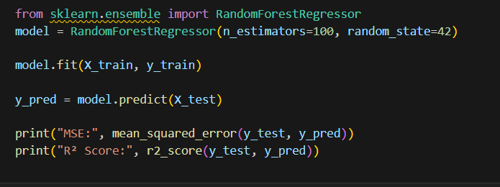
Model Development

Slide 15
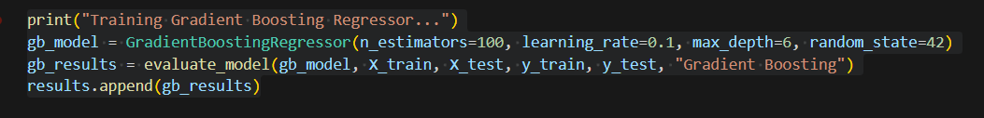
Model Development

Slide 16
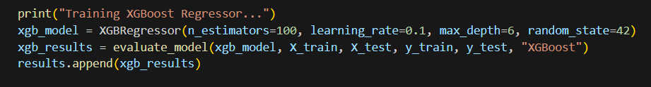
Model Development

Slide 17
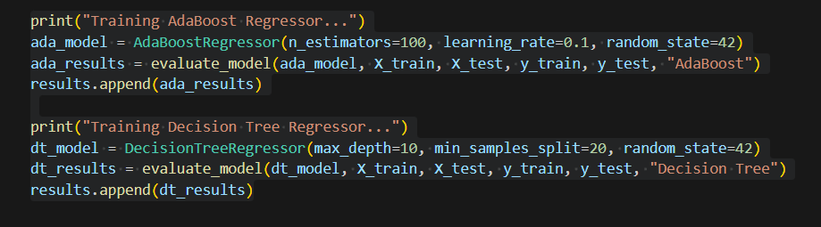
Model Development

Slide 18
Model Evaluation and Comparison

Slide 19
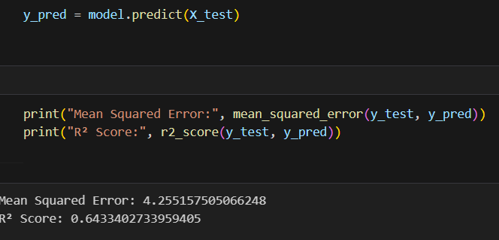
Linear regression

Slide 20
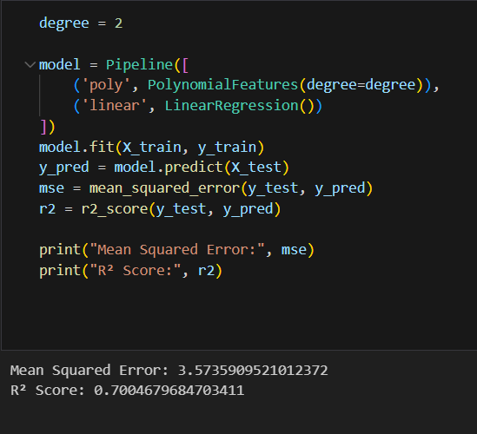
Linear polynomial regression

Slide 21
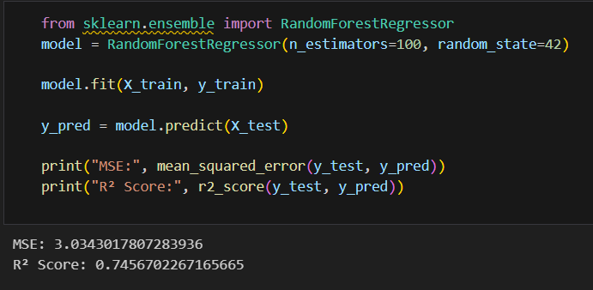
Random forest regression

Slide 22
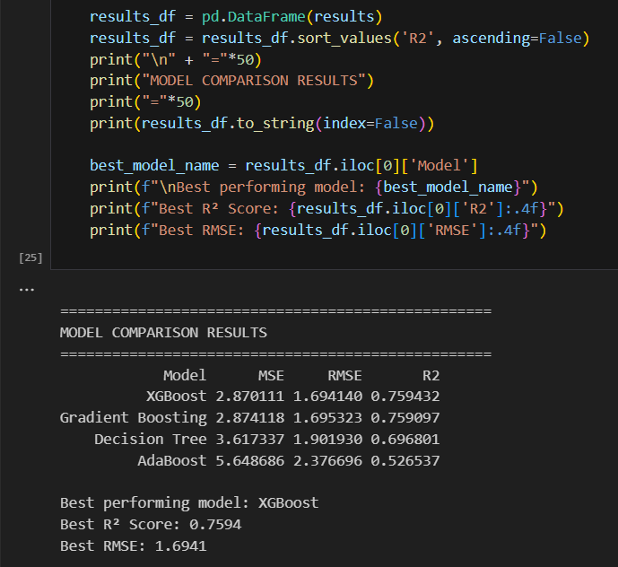
Model evaluation and comparison

Slide 23
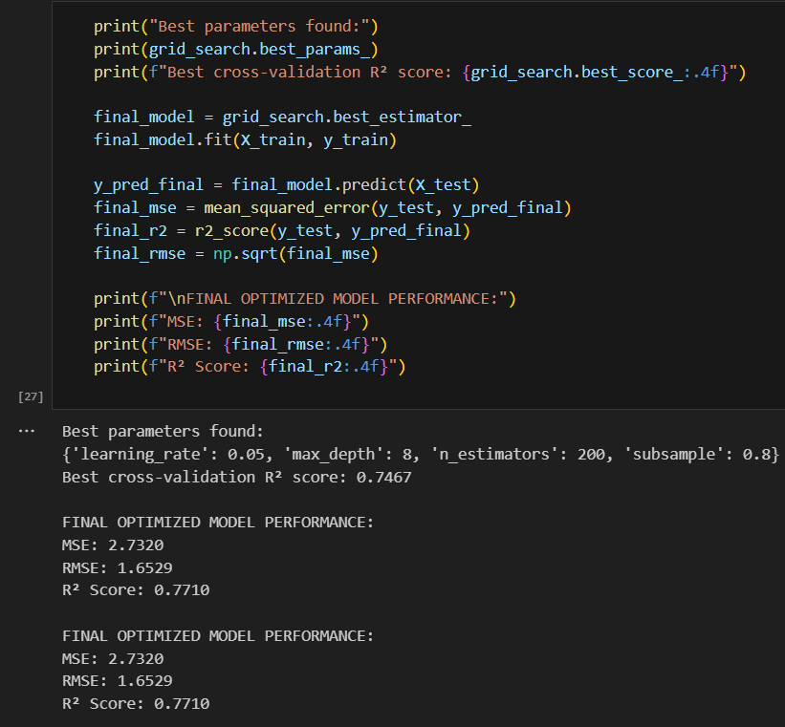
Model evaluation and comparison

Slide 24
Model evaluation and comparison

Slide 25
Model evaluation and comparison

Slide 26
Interface design and implementation

Slide 27
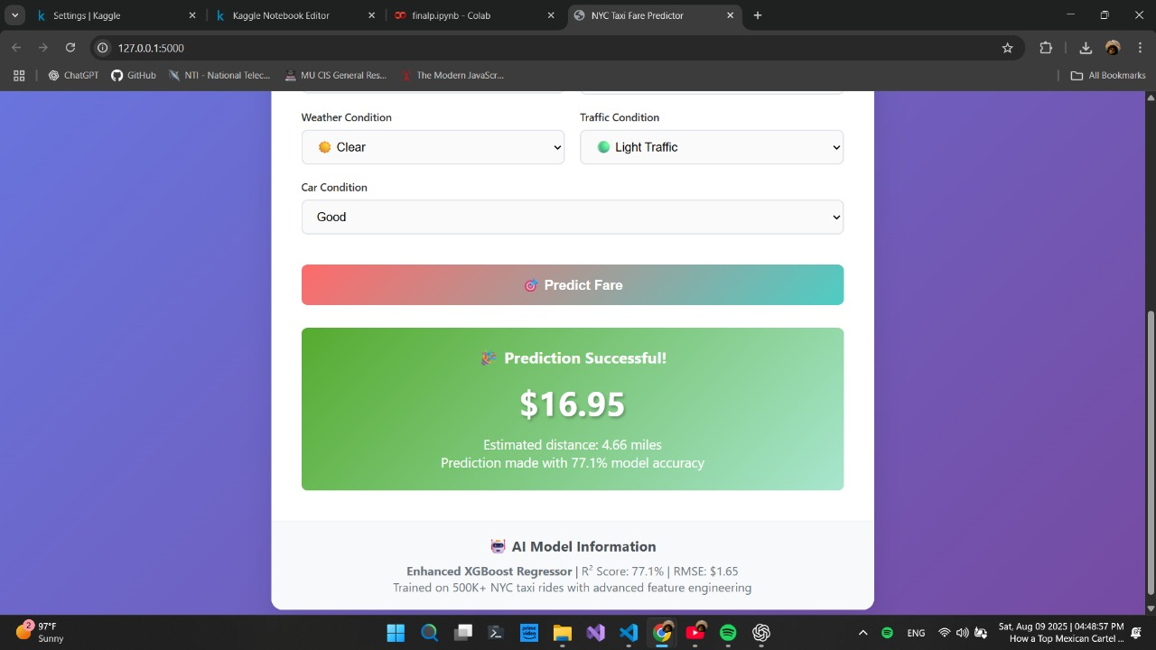
Interface design and implementation

